Slide 1
FOUNDATION FUNDING AND FUNDRAISING
Notes:
Welcome message

Slide 2
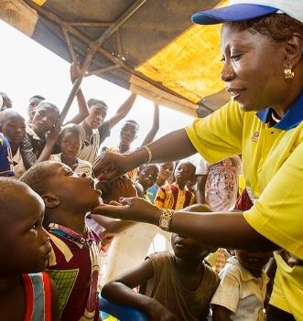


WHAT IS THE ROTARY FOUNDATION?
The mission of The Rotary Foundation is to enable Rotarians to advance world understanding, goodwill, and peace through the improvement of health, the support of education, and the alleviation of poverty.
Notes:
The Rotary Foundation is a primary source of funding for Rotary’s humanitarian activities and Rotary’s effort to eradicate polio worldwide.
Our Foundation is able to achieve its mission through the generous contributions and active participation of Rotarians and friends of Rotary.

Slide 3


OUR FOUNDATION IS UNIQUE
Notes:
Our Rotary Foundation is unique: It belongs to Rotarians and is dedicated to furthering Rotary programs that address the greatest needs around the world.
We are in the top 1 percent of U.S.-based charities according to independent ratings organizations.
Because Rotary clubs operate in nearly every country in the world, Rotarians truly constitute a global network of community volunteers.

Slide 4

OUR FOCUS
Peace and conflict prevention/resolution
Disease prevention and treatment
Water and sanitation
Maternal and child health
Basic education and literacy
Economic and community development
Notes:
Our areas of focus support the Rotary Foundation mission.
Whether it’s educating a scholar in peace and conflict resolution, preventing polio, digging wells, or providing training to teachers at a local elementary school, Rotary creates the environment and circumstances that promote Doing Good in the World.

Slide 5
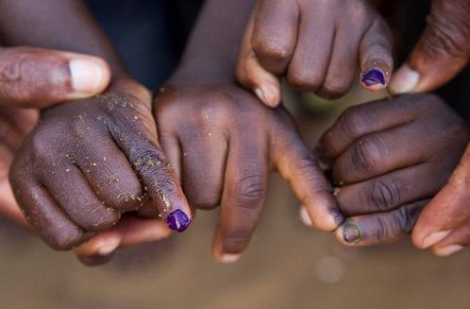
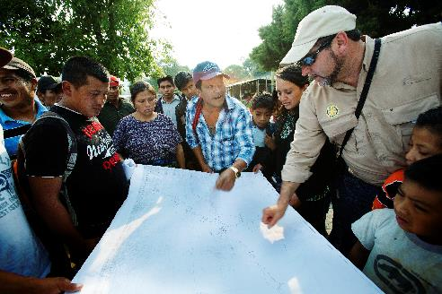
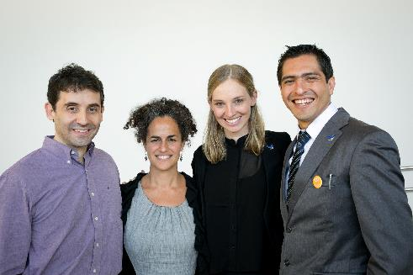
SUPPORTING THE ROTARY FOUNDATION
PolioPlus Fund
End Polio Now
Annual Fund
For Support Today
Endowment Fund
To Secure Tomorrow
Notes:
Rotarians can support three main funds:
The PolioPlus Fund, to help us eradicate polio worldwide.
The Annual Fund, to support Rotary’s work today.
The Endowment Fund, to support Rotary’s future work.

Slide 6
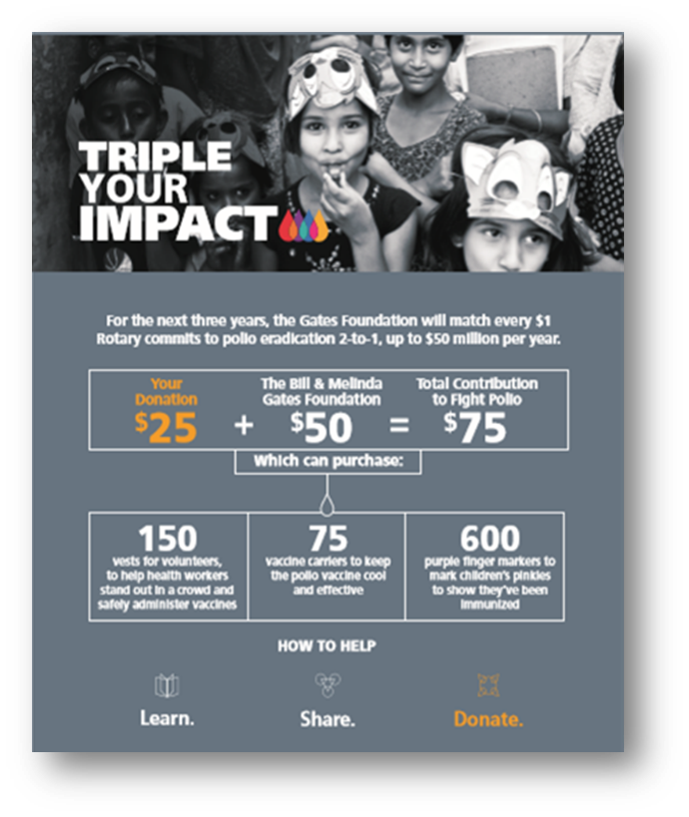
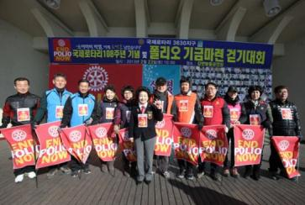
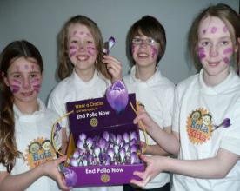

POLIOPLUS FUND
Notes:
Contributions to the PolioPlus Fund support polio eradication efforts around the world.
Rotary and the Bill & Melinda Gates Foundation are working together to End Polio Now.
From 2017 to 2020, every $1 that Rotary commits in direct support of polio immunization (up to $50 million per year) will be matched by an additional $2 from the Gates Foundation. This means your contributions to the PolioPlus Fund will have three times the impact.

Slide 7
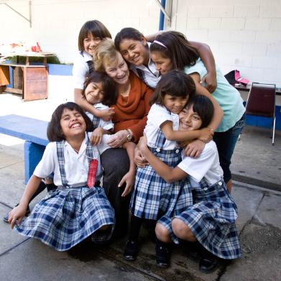
ROTARY’S ENDOWMENT
Contributions are professionally invested.
Only the earnings are spent.
Notes:
Gifts to the Endowment Fund, or Endowment, are professionally invested, with part of the earnings used each year for purposes that the Trustees and donors specify. The principal of your gift is never spent and is held in perpetuity.
The Endowment offers donors a way to ensure a strong future for The Rotary Foundation.

Slide 8
WHY SUPPORT ROTARY’S ENDOWMENT
Gifts are not spent, but rather invested.
When they give to the Endowment, donors know that their gift will affect lives for generations.
The earnings provides ongoing support to Foundation grants and programs.
It offers a long-term impact.
Notes:
Donors who support the Endowment help secure a strong financial future for The Rotary Foundation.
Contributions to the Endowment are not spent like Annual Fund contributions. With the Endowment, they are invested and generate earnings in perpetuity.
The Endowment lets donors know that their gift will affect lives for generations.
Supporters have various opportunities to direct their giving to Foundation programs.

Slide 9
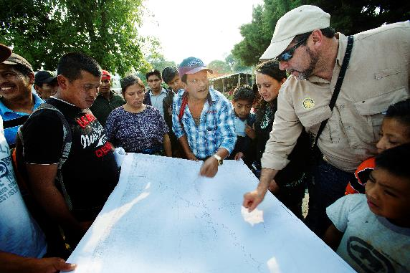
ANNUAL FUND
Fund for Rotary grants
Contributions are credited to the donor’s club and applied to the club’s goal
Contributions generate District Designated Funds (DDF)
Notes:
Contributions to the Annual Fund supports Foundation activities.
Contributions are credited to the donor and the donor’s club, and they count toward the club’s and district’s Annual Fund goals.
Contributions to the Annual Fund enter the SHARE system and generate District Designated Funds (DDF), which are used to support local and international projects.

Slide 10
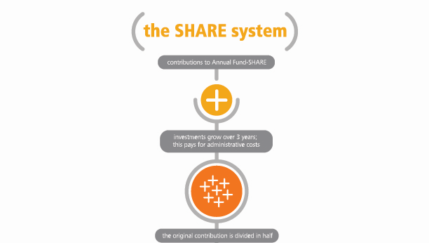
SHARE SYSTEM
Notes:
What is the SHARE system?
Contributions from Rotarians and friends of Rotary fund Rotary Foundation grants and programs.
Only when donors designate Annual Fund-SHARE for their gifts do they enter the SHARE system.
Donors designating their gifts for Endowment Fund-SHARE have their spendable earnings enter the SHARE system.
Gifts to the PolioPlus Fund do not enter the SHARE system.

Slide 11
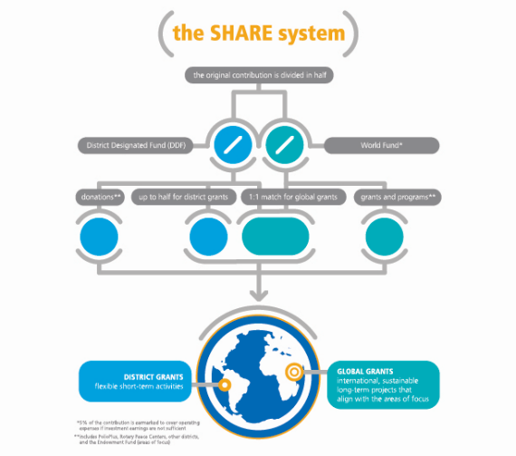
SHARE SYSTEM
Notes:
The SHARE system divides the funds between the World Fund and District Designated Fund (DDF).
District Designated Funds are used for Rotary grants and activities that do good in the world. The Trustees decide how the World Fund is spent.
Each district’s Rotary Foundation committee decides how its DDF is spent.

Slide 12
SHARE PROCESS
DDF
Unspent funds roll forward
Funds raised
Funds spent
2016-17
2017-18
2018-19
2019-20
2020-21
Global grants
District grants
1:1 Match
Donations
World Fund
Notes:
The DDF that a district has available is the result of gifts made by donors in that district three years prior. This three-year funding cycle allows the funds to be invested so the earnings can help pay for administrative and fund development costs. It also allows the district to plan how to allocate the DDF that will become available.
There are three options for spending DDF:
Global grants — DDF allocated to this type of grant is matched dollar for dollar by the World Fund.
District grants — DDF allocated to this type of grant is used as a block grant with a maximum award amount, which is calculated each year based on a percentage of the funds available that year.
Donations — DDF allocated for PolioPlus or the Rotary Peace Centers, for example, will be considered a donation.
If the district has a remaining balance of funds at the end of the Rotary year, the funds roll forward and add to the following year’s DDF balance.

Slide 13
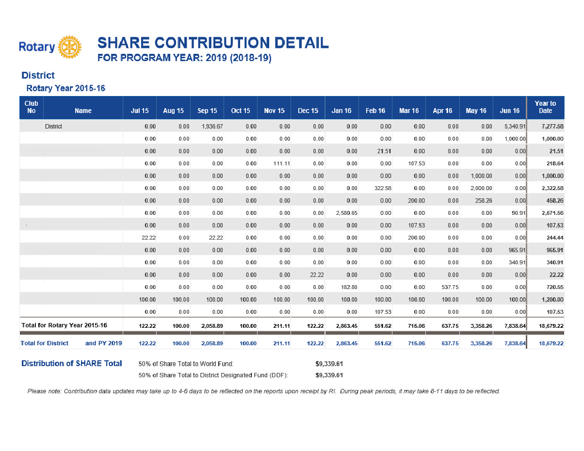
SHARE CONTRIBUTION DETAIL REPORT
Notes:
SHARE CONTRIBUTION DETAIL REPORT
Club officers, such as the club Foundation chair, have access online via My Rotary to the SHARE Contribution Detail Report. This report shows each club’s Annual Fund-SHARE contributions and the DDF that will result in three years.

Slide 14
WHY SUPPORT THE ANNUAL FUND
Contributions:
Fund club and district projects
Help you build your donor base
Can lead to individual and club recognition
Notes:
The Rotary Foundation’s impact depends on you.
Your support of Annual Fund-SHARE translates into Rotary grants organized by your club.
A healthy, strong Annual Fund allows Rotarians around the world to keep doing good through local and international projects. That’s why it’s advisable for clubs to maintain consistent support of the Annual Fund.
Giving to the Annual Fund is also the way that many donors first support Rotary. Donors who give to the Annual Fund are your core donor base. Be sure to thank them for their support and keep them informed of your club’s Foundation activities.
Donors who consistently give to the Annual Fund can work toward becoming a Paul Harris Fellow, Rotary’s best-known recognition, or join the Paul Harris Society.
ASK: What is the giving pattern among your club members? What are some ways that you can motivate them to continue supporting the Foundation?
ASK: How can you use Rotary’s recognition levels to inspire donors to increase their support?
ASK: What is an example of a successful club-organized fundraiser that generated support for The Rotary Foundation?

Slide 15

GENERATING ANNUAL FUND SUPPORT
Set fundraising goals
Engage new members
Hold a fundraiser for a Rotary area of focus
Recognize club members
Notes:
Now that you know why it’s important to support the Annual Fund, here are a few ideas for helping your club have a strong Annual Fund.
1. Set fundraising goals: Clubs that set a goal achieve higher levels of giving than clubs that do not. Consider setting at minimum an Annual Fund and PolioPlus goal.
2. Engage new members: Connect your new members with our Foundation’s good works by sharing videos, images, and statistics that show the Foundation at work. Ask new members to participate in a Foundation-funded project or invite them to support the Foundation through Rotary Direct, the Foundation’s recurring giving program.
3. Hold an area of focus fundraiser: Let your community know about the great work of Rotary by holding a fundraiser for one of our six areas of focus. This is a great opportunity to give an update about a project that your district or club is doing in one of the six areas of focus. For fundraising ideas, visit the Fundraising page in the Learning & Reference section of My Rotary.
Go to the Learning & Reference drop-down menu, choose Learn by Topic, then Fundraising.
4. Recognize club members: Set aside time to thank club members for their contributions. A thank-you card can show appreciation and lead to continued support.
Ask: What other methods for generating support have been successful in your club?

Slide 16
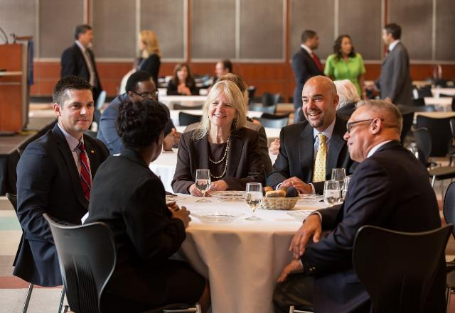
DONOR STEWARDSHIP
Ways to thank individual donors:
Make calls
Present donors with pins
Send thank-you notes
Recognize donors at events
Feature donors in newsletters
Notes:
Recognition is one of the best ways to thank individuals who generously support The Rotary Foundation.
Recognition opportunities not only allow us to thank donors for their support but add incentives for giving and can inspire others to give as well.
Say thank you at a club meeting and consider recognizing new Paul Harris Fellows at a multi-club or district event.
Always ask a donor how they’d like to be recognized for their gift – some individuals do not like to be recognized publicly.

Slide 17
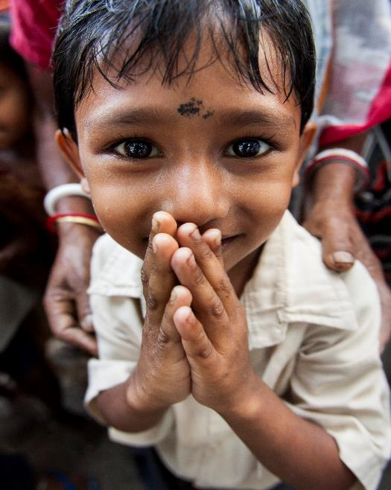
CLUB RECOGNITION
100% Foundation Giving Club
Every Rotarian, Every Year Club
Top Three Per Capita Clubs in Annual Fund Giving
100% Paul Harris Fellow Club
100% Paul Harris Society Club
Notes:
Like individual donors, clubs generously contribute to The Rotary Foundation. Recognizing and thanking clubs helps build a culture of giving among members.
Club banners are sent to the sitting district governor; many governors choose to present banners to clubs at Foundation dinners or district conferences:
100% Foundation Giving Club: This banner is awarded to clubs that achieve a $100 average and 100 percent participation, with every dues-paying member contributing at least $25 to any or all of the following during the Rotary year: Annual Fund, PolioPlus Fund, approved global grants, and Endowment Fund.
Every Rotarian, Every Year Club: This banner is awarded to clubs that achieve $100 per-capita giving and 100 percent participation, with every dues-paying member contributing at least $25 to the Annual Fund during the Rotary year.
Top Three Per Capita Clubs: Banners go to the three clubs in each district that give the most, per capita, to the Annual Fund. Clubs that give at least $50 per capita are eligible.
100% Paul Harris Fellow Club: For clubs in which all dues-paying members are Paul Harris Fellows. This is a one-time recognition.
100% Paul Harris Society Club: This recognition is awarded to clubs in which every dues-paying member has contributed a minimum of $1,000 outright to the Annual Fund, PolioPlus Fund, or an approved global grant during a given Rotary year.
Learn more about recognition at My Rotary. Choose The Rotary Foundation drop-down menu, go to the Give section, then go to Donor Recognition.

Slide 18
FOUNDATION REPORTS
Club Recognition Summary
Paul Harris Society Report
Club Foundation Banner Report
SHARE Contribution Detail Report
Benefactor Report
Major Donor, Arch Klumph Society, and Bequest Society Report
Notes:
How do you find accurate information to thank your members for their contributions?
Club officers can run Foundation reports on Rotary.org to find information:
Club Recognition Summary: Includes members’ Paul Harris Fellow status, recognition amount, available Foundation recognition points, Rotary Direct participation, and most recent contribution date and designation. The report also indicates 100% Paul Harris Fellow Club achievement and date, along with clubs’ all-time Foundation giving. The report can also be used to identify noncontributing clubs.
Paul Harris Society Report: Includes members’ Paul Harris Society status and a four-year history of eligibility, as well as a tab with donor contact information.
Club Foundation Banner Report: Includes eligibility dates achieved for the recognition Every Rotarian, Every Year, along with Rotary Foundation giving.
SHARE Contribution Detail Report: Shows each club’s Annual Fund-SHARE contributions and the District Designated Funds that will result in three years. Club officers, such as the Foundation chair, have access on My Rotary to this report.
Benefactor Report: Includes a list of Paul Harris Fellows and Benefactors of The Rotary Foundation, with achieved date, donor ID, and Rotary club.
Major Donor, Arch Klumph Society, and Bequest Society Report: Includes lists of Major Donors, Bequest Society members, and Arch Klumph Society members, with their recognition dates. The report also has two tabs with mailing address information.

Slide 19
RESOURCES
Rotary Foundation videos
Publications
  Annual Reports
  Rotary Foundation Facts
  Rotary Foundation Reference Guide
My Rotary Fundraising page
Rotary Direct frequently asked questions
Notes:
Recommended resources:
Rotary videos: Videos produced by Rotary International’s broadcast media department are viewable at www.vimeo.com/rotary; most can be embedded or downloaded. Be sure to search for “Our Causes” to find most TRF videos.
The Rotary International/Rotary Foundation Annual Report: Online report of the major events and achievements of the 2016-17 Rotary year, along with highlights from audited financial statements (https://www.rotary.org/en/annual-report-2017).
Rotary Foundation Facts: This brochure, suitable for general distribution, gives a brief, statistical overview of the Foundation, its programs, and contribution information.
The Rotary Foundation Reference Guide: https://www.rotary.org/myrotary/en/document/rotary-foundation-reference-guide
My Rotary Fundraising page: www.rotary.org/myrotary/en/learning-reference/learn-topic/fundraising
Rotary Direct: The Foundation’s recurring-giving program has a list of answers to frequently asked questions.

Slide 20
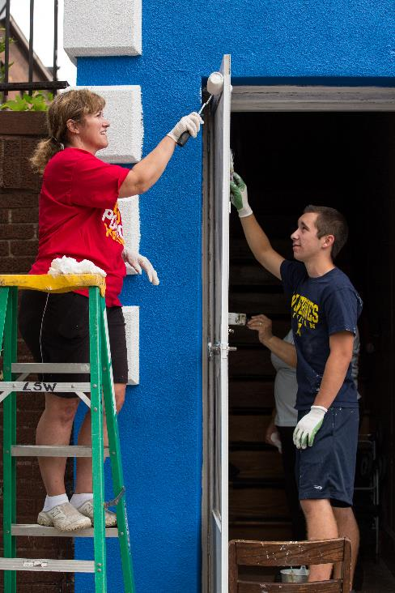
TAKE ACTION
Lead by example and make a gift every year
Discuss your spending plan for District Designated Funds
Advocate for our Foundation
Thank donors
Notes:
Note to presenter:
Have Rotary Foundation contribution forms printed

Slide 21
Questions?
rotarysupportcenter@rotary.org
Notes:
Ask participants for questions.
Review contact information.

